Slide 1
DVD Rentals Sample Report
Made by Hady Ayman

Slide 2
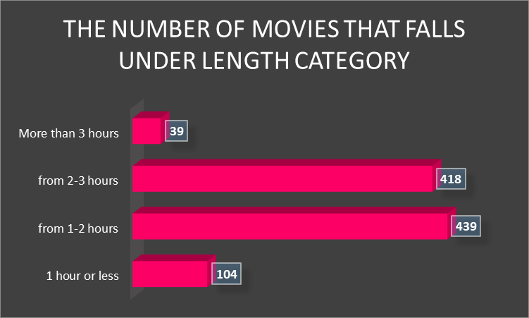
What are the classification of movies due to length and how many movies are in each category?
We can see that the movies that falls in the (1-2 hours) category has the most movies and we can notice that there is a slight difference between the second category (2-3 Hours) and the Third category (1-2 Hours)

Slide 3
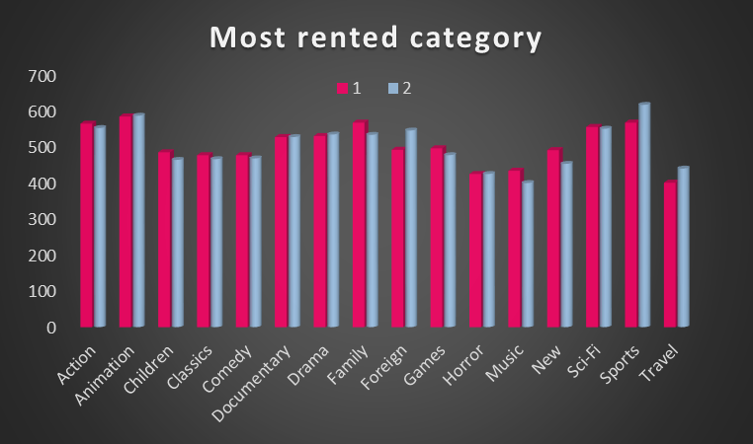
What is the most rented categories by store?
As we can see that in store 1 the highest rented category is Animation and for store 2 the highest is Sports

Slide 4
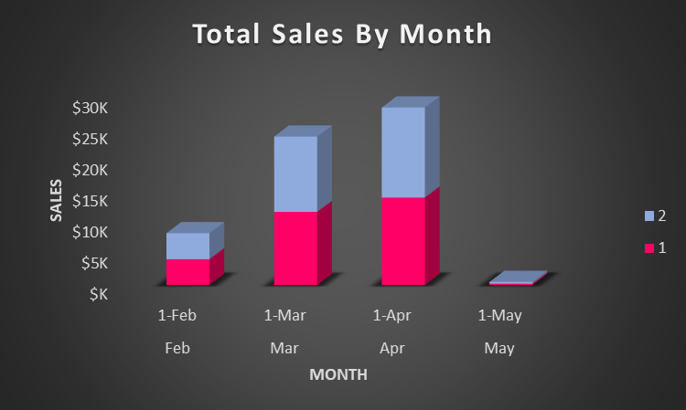
What is the total sales for each store in each month during 2007?
Here we can notice that store 2 has higher sales than store 1 in each month with a peak of $14,479.1 while the peak of store 1 is $14,080.36.

Slide 5
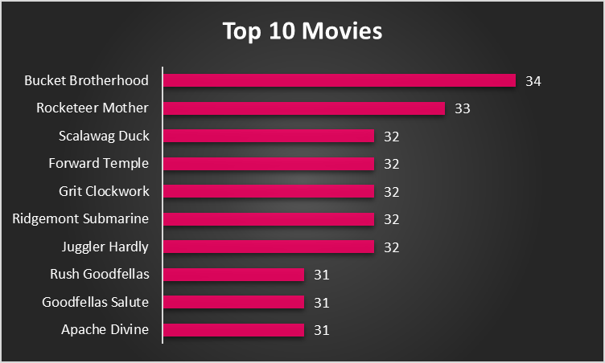
What are the top 10 Movies rented out?
This Graph shows the top 10 rented movies from our database

